Slide 1


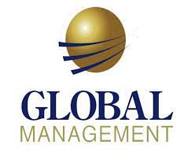

GLOBAL MANAGEMENT
UNIT 3

Slide 2
LEARNING OUTCOME
Contrast ethnocentric, polycentric, and geocentric attitudes toward global business.
Discuss the importance of regional trading alliances and global trade mechanisms.
Describe the structures and techniques organizations use as they go international.
Explain the relevance of the political/legal, economic, and cultural environments to global business.

Slide 3
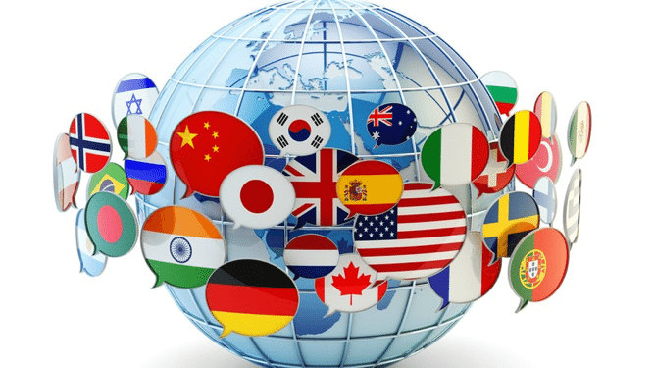
WHAT’S YOUR GLOBAL PERSPECTIVE?
There are three possible global attitudes in managing
Ethnocentric Attitude - the parochialistic belief that the best work approaches and practices are those of the home country.
Polycentric Attitude - the view that the managers in the host country know the best work approaches and practices for running their business.
Geocentric Attitude - a world-oriented view that focuses on using the best approaches and people from around the globe.
Notes:
Monolingualism is one sign that a nation suffers from parochialism—viewing the world solely through one’s own eyes and perspectives. People with a parochial attitude do not recognize that others have different ways of living and working. They ignore others’ values and customs and rigidly apply an attitude of “ours is better than theirs” to foreign cultures.
This type of narrow, restricted attitude is one approach that managers might take, but isn’t the only one. In fact, there are three possible global attitudes. Let’s look at each more closely.
First, an ethnocentric attitude is the parochialistic belief that the best work approaches and practices are those of the home country (the country in which the company’s
headquarters are located). Managers with an ethnocentric attitude believe that people in foreign countries don’t have the needed skills, expertise, knowledge, or experience
to make the best business decisions as people in the home country do.
A polycentric attitude is the view that employees in the host country (the foreign country in which the organization is doing business) know the best work approaches
And practices for running their business. Managers with this attitude view every foreign operation as different and hard to understand. Thus, they’re likely to let employees there figure out how best to do things.
A geocentric attitude is a world-oriented view that focuses on using the best approaches and people from around the globe. Managers with this type of attitude have a global view and look for the best approaches and people regardless of origin.

Slide 4
UNDERSTANDING THE GLOBAL ENVIRONMENT – TRADING ALLIANCES
Global competition and the global economy are shaped by regional trading agreements, including the European Union (EU), North American Free Trade Agreement (NAFTA), the Association of Southeast Asian Nations (ASEAN), and others.
The European Union (EU) is an economic and political partnership of 27 democratic European countries. Eight countries (Croatia, the former Yugoslav Republic of Macedonia, Turkey, Albania, Bosnia-Hercegovina, Iceland, Montenegro, and Serbia) are candidates to join the EU.
When the 12 original members formed the EU in 1992, the primary motivation was to reassert the region’s economic position against the United States and Japan. Before then, each European nation had border controls, taxes, and subsidies; nationalistic policies; and protected industries. Now with these barriers removed, the economic power represented by the EU is considerable.
Its current membership covers a population base of more than half a billion people (7 percent of the world population) and accounts for approximately 31 percent of the world’s total economic output.
Another step toward full unification occurred when the common European currency, the euro, was adopted. The euro is currently in use in 17 of the 27 member states, and all new member countries must adopt the euro. Only Denmark, the United Kingdom, and Sweden have been allowed to opt out of using the euro

Slide 5
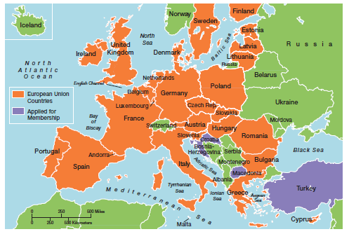
EXHIBIT 3-1 EUROPEAN UNION MAP

Slide 6
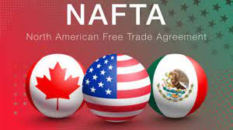
TRADING ALLIANCES (CONT.)
North American Free Trade Agreement (NAFTA) - an agreement among the Mexican, Canadian, and U.S. governments in which certain barriers to trade have been eliminated.
Notes:
When agreements in key issues covered by the North American Free Trade Agreement (NAFTA ) were reached by the Mexican, Canadian, and U.S. governments in 1992, a vast economic bloc was created. As of 2012, it is the second largest trade bloc in the world in terms of combined GDP of its members.
Between 1994, when NAFTA went into effect, and 2007 (the most recent year for complete statistics), merchandise trade between the United States and Canada and Mexico has more than tripled while trade between Mexico and the United States has more than quadrupled. Put into numbers, that translates to some $2.6 billion exchanged on a daily basis among NAFTA partners.
Other Latin American nations have also become part of free trade blocs. Colombia, Mexico, and Venezuela led the way when all three signed an economic pact in 1994 eliminating import duties and tariffs. Another agreement, the U.S.–Central America Free Trade Agreement (CAFTA), promotes trade liberalization between the United States and five Central
American countries: Costa Rica, El Salvador, Guatemala, Honduras, and Nicaragua. However, only El Salvador and Costa Rica have joined.
However, another free trade bloc of 10 South American countries known as the Southern Common Market or Mercosur already exists. Some South Americans see Mercosur as an effective way to combine resources to better compete against other global economic powers, especially the EU and NAFTA. With the future of FTAA highly doubtful, this regional alliance could take on new importance

Slide 7
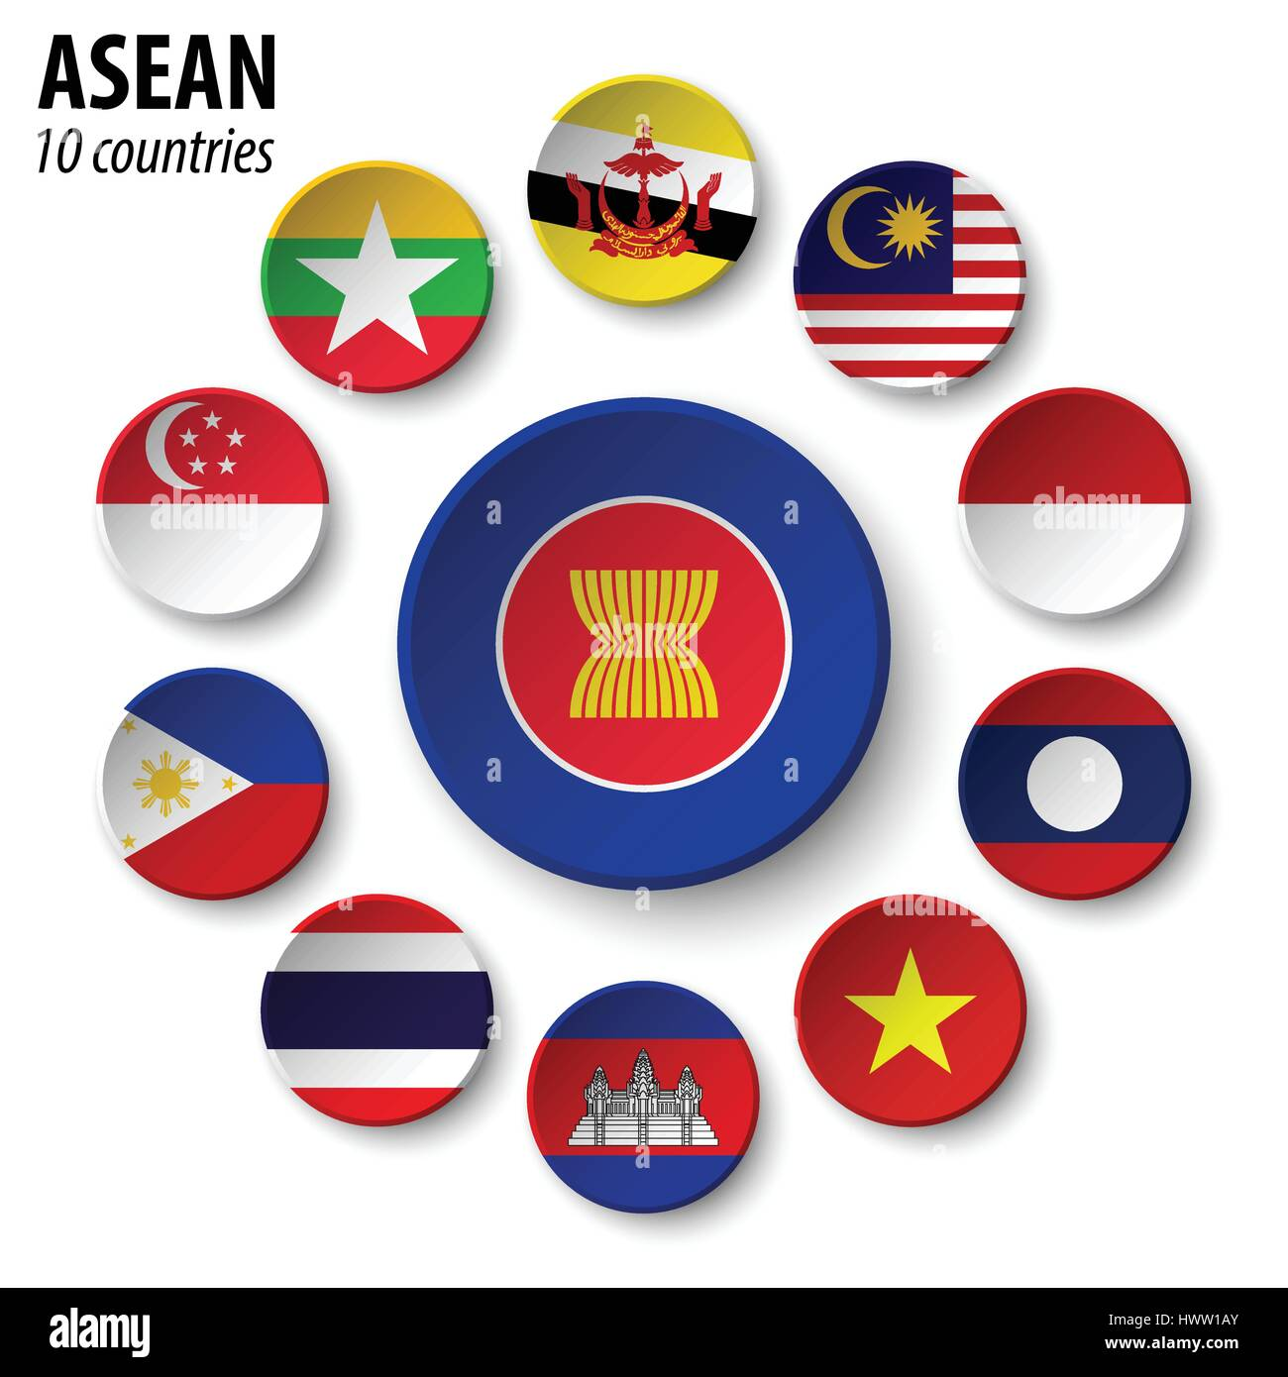
TRADING ALLIANCES(CONT.)
Association of Southeast Asian Nations (ASEAN) - A trading alliance of 10 Southeast Asian nations
Notes:
The Association of Southeast Asian Nations (ASEAN ) is a trading alliance of 10 Southeast Asian nations. (See Exhibit 3-2.) The ASEAN region has a population more than 591 million with a combined GDP of US$1.5 trillion. In addition to these 10 nations, leaders from a group dubbed ASEAN+3, which include China, Japan, and South Korea, have
met to discuss trade issues. Also, leaders from India, Australia, and New Zealand have participated in trade talks with ASEAN+3 as well. The main issue with creating a trade bloc of all 16 nations has been the lack of any push toward regional integration. Despite the Asian culture’s emphasis on consensus building, “ASEAN’s biggest problem is that individual members haven’t been willing to sacrifice for the common good.”

Slide 8
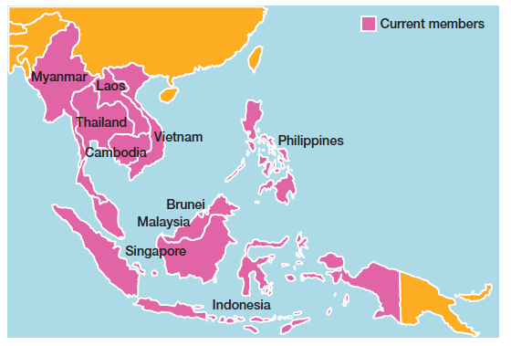
EXHIBIT 3-2 ASEAN MAP
Notes:
Despite the barriers and challenges, progress toward regional integration continues. This fast-growing region means ASEAN and other Asian trade alliances. will be increasingly important globally with an impact that eventually could rival that of both NAFTA and the EU.

Slide 9
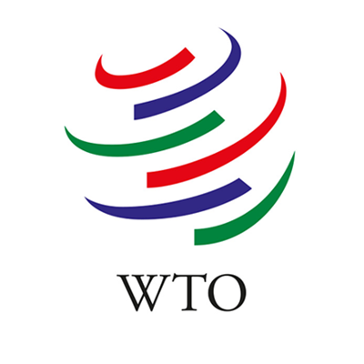

GLOBAL TRADE MECHANISMS
World Trade Organization (WTO) - a global organization of 153 countries that deals with the rules of trade among nations.
International Monetary Fund (IMF) - an organization of 185 countries that promotes international monetary cooperation and provides advice, loans, and technical assistance.

Slide 10
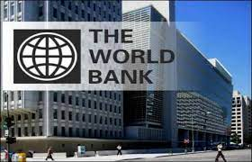
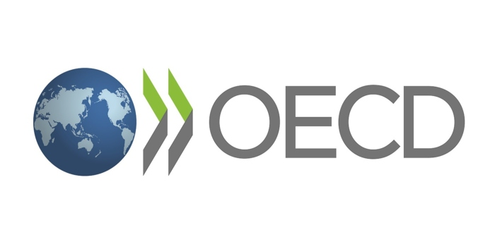
GLOBAL TRADE MECHANISMS (CONT.)
World Bank Group - a group of five closely associated institutions that provides financial and technical assistance to developing countries.
Organization for Economic Cooperation and Development (OECD) - an international economic organization that helps its 30 member countries achieve sustainable economic growth and employment.
Notes:
The World Bank Group is a group of five closely associated institutions, all owned by its member countries, that provides vital financial and technical assistance
to developing countries around the world. The goal of the World Bank Group is to promote long-term economic development and poverty reduction by providing members
with technical and financial support.
The forerunner of the OECD, the Organization for European Economic Cooperation, was formed in 1947 to administer American and Canadian aid under the Marshall
Plan for the reconstruction of Europe after World War II. Today, the Organization for Economic Cooperation and Development (OECD) is a Paris-based international
economic organization whose mission is to help its 34 member countries achieve sustainable economic growth and employment and raise the standard of living in member countries while maintaining financial stability in order to contribute to the development of the world economy.

Slide 11
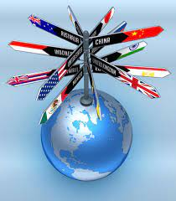
TYPES OF INTERNATIONAL ORGANIZATIONS
Multinational Corporation (MNC) - a broad term that refers to any and all types of international companies that maintain operations in multiple countries.
Multidomestic Corporation - an MNC that decentralizes management and other decisions to the local country.
Notes:
Today, few companies don’t do business internationally. However, there’s not a generally accepted approach to describe the different types of international companies; different authors call them different things. We use the terms multinational, multidomestic, global, and transnational.
A multinational corporation (MNC) is any type of international company that maintains operations in multiple countries. One type of MNC is a multidomestic corporation, which decentralizes management and other decisions to the local country. This type of globalization reflects the polycentric attitude. A multi-domestic corporation doesn’t attempt to replicate its domestic successes by managing foreign operations from its home country. Instead, local employees typically are hired to manage the business and marketing strategies
are tailored to that country’s unique characteristics

Slide 12
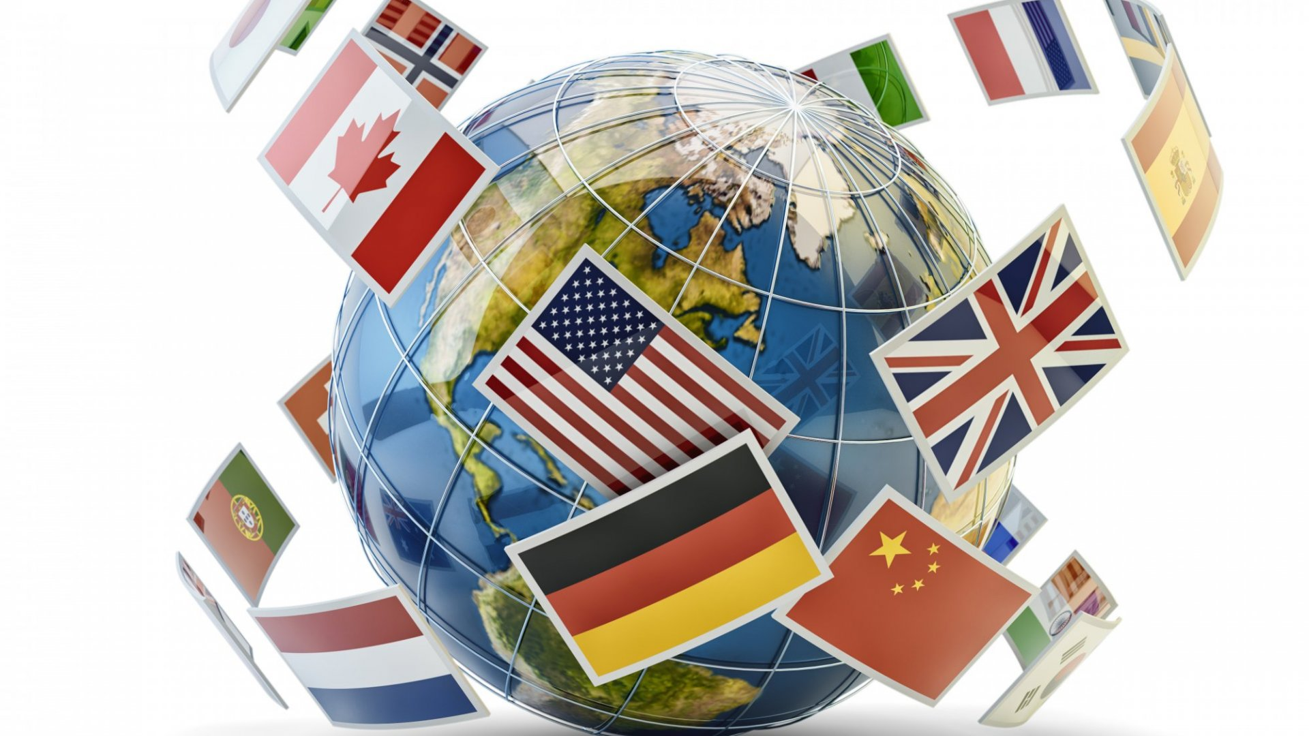
TYPES OF INTERNATIONAL ORGANIZATIONS (CONT.)
Global Company - an MNC that centralizes management and other decisions in the home country.
Transnational or Borderless Organization - an MNC in which artificial geographical barriers are eliminated.
Notes:
Another type of MNC is a global company, which centralizes its management and other decisions in the home country. This approach to globalization reflects
the ethnocentric attitude. Global companies treat the world market as an integrated whole and focus on the need for global efficiency and cost savings. Although these
companies may have considerable global holdings, management decisions with company-wide implications are made from headquarters in the home country.
Other companies use an arrangement that eliminates artificial geographical barriers. This type of MNC is often called a transnational, or borderless, organization
and reflects a geocentric attitude. For example, IBM dropped its organizational structure based on country and reorganized into industry groups and Ford Motor Company is pursuing what it calls the One Ford concept as it integrates its operations around the world

Slide 13
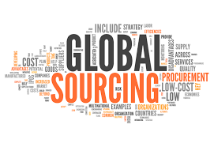
HOW ORGANIZATIONS GO GLOBAL
Global Sourcing - purchasing materials or labor from around the world wherever it is cheapest.
Exporting - making products domestically and selling them abroad.
Notes:
When organizations do go international, they often use different approaches. Managers who want to get into a global market with minimal investment may start with global sourcing (also called global outsourcing), which is purchasing materials or labor from around the world wherever it is cheapest. The goal: take advantage of lower costs in order to be more competitive.
The next step in going international may involve exporting the organization’s products to other countries—that is, making products domestically and selling them
abroad.

Slide 14
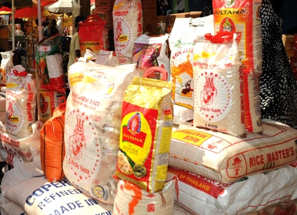
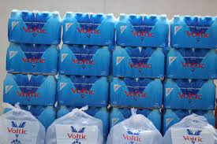
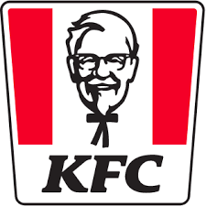
GOING GLOBAL (CONT.)
Importing - acquiring products made abroad and selling them domestically.
Licensing - an organization gives another organization the right to make or sell its products using its technology or product specifications.
Franchising - an organization gives another organization the right to use its name and operating methods.
Notes:
In addition, an organization might do importing, which involves acquiring products made abroad and selling them domestically. Both usually entail minimal investment
and risk, which is why many small businesses often use these approaches to doing business globally.
Managers also might use licensing or franchising, which are similar approaches involving one organization giving another organization the right to use its brand name, technology, or product specifications in return for a lump sum payment or a fee usually based on sales. The only difference is that licensing is primarily used by manufacturing organizations that make or sell another company’s products and franchising is primarily used by service organizations that want to use another company’s name and operating methods.

Slide 15

GOING GLOBAL (CONT.)
Strategic Alliance - a partnership between an organization and one or more foreign company partner(s) in which both share resources and knowledge in developing new products or building production facilities.
Joint Venture - a specific type of strategic alliance in which the partners agree to form a separate, independent organization for some business purpose.
Notes:
When an organization has been doing business internationally for a while and has gained experience in international markets, managers may decide to make
more of a direct foreign investment. One way to increase investment is through a strategic alliance, which is a partnership between an organization and a foreign company
partner or partners in which both share resources and knowledge in developing new products or building production facilities. For example, Honda Motor and General Electric teamed up to produce a new jet engine.
A specific type of strategic alliance in which the partners form a separate, independent organization for some business purpose is called a joint venture. For example, Hewlett-Packard has had numerous joint ventures with various suppliers around the globe to develop different components for its computer equipment. These partnerships provide a relatively easy way for companies to compete globally.

Slide 16
GOING GLOBAL (CONT.)
Foreign Subsidiary - directly investing in a foreign country by setting up a separate and independent production facility or office.
Notes:
Finally, managers may choose to directly invest in a foreign country by setting up a foreign subsidiary as a separate and independent facility or office. This subsidiary
can be managed as a multi-domestic organization (local control) or as a global organization (centralized control). As you can probably guess, this arrangement involves
the greatest commitment of resources and poses the greatest amount of risk.

Slide 17
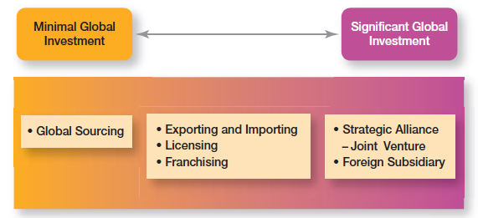
EXHIBIT 3-3 HOW ORGANIZATIONS GO GLOBAL
Notes:
Exhibit 3-3 shows the different approaches to doing business globally. Although global sourcing may be the first step to going international for many companies, they often
continue to use this approach because of the competitive advantages it offers. Each successive stage of going international beyond global sourcing, however, requires
more investment and thus entails more risk for the organization.

Slide 18
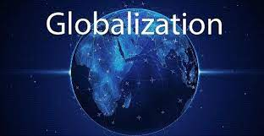
MANAGING IN A GLOBAL ENVIRONMENT
Political/ Legal Environment
Economic Environment
Cultural Environment

Slide 19
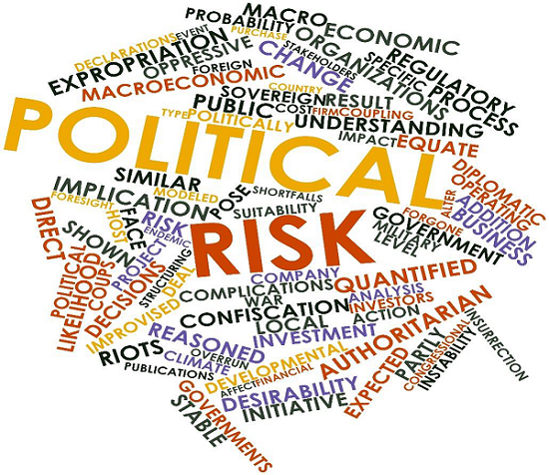
THE POLITICAL/LEGAL ENVIRONMENT
U.S. managers are accustomed to a stable legal and political system
Managers must stay informed of the specific laws in countries where they do business
Some countries have risky political climates

Slide 20

THE ECONOMIC ENVIRONMENT
Free Market Economy - an economic system in which resources are primarily owned and controlled by the private sector.
Planned Economy - an economic system in which economic decisions are planned by a central government.

Slide 21

THE CULTURAL ENVIRONMENT
National Culture - the values and attitudes shared by individuals from a specific country that shape their behavior and beliefs about what is important.
Hofstede’s framework for assessing cultures - one of the most widely referenced approaches to helping managers better understand differences between national cultures.

Slide 22
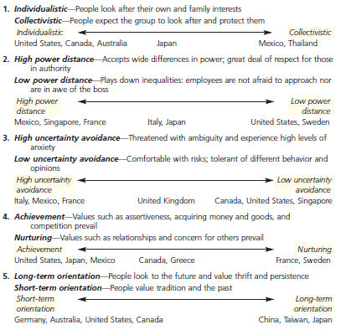
EXHIBIT 3-4 HOFSTEDE’S FIVE DIMENSIONS OF NATIONAL CULTURE

Slide 23

GLOBAL MANAGEMENT IN TODAY’S WORLD
Global Leadership and Organizational Behavior Effectiveness (GLOBE) program - a research program that studies cross-cultural leadership behaviors.
Notes:
The Global Leadership and Organizational Behavior Effectiveness (GLOBE) is an ongoing research program that extended Hofstede’s work by investigating cross-cultural leadership behaviors and giving managers additional information to help them identify and manage cultural differences. Using data from more than 18,000 managers in 62 countries, the GLOBE research team (led by Robert House) identified nine dimensions on which national cultures differ.
Two dimensions (power distance and uncertainty avoidance) fit directly with Hofstede’s. Four are similar to Hofstede’s (assertiveness, which is similar to achievement-nurturing; humane orientation, which is similar to the nurturing dimension; future orientation, which is similar to long-term and short-term orientation; and institutional collectivism, which is similar to individualism-collectivism). The remaining three (gender differentiation, in-group collectivism, and performance orientation) offer additional insights into a country’s culture.
The GLOBE studies confirm that Hofstede’s dimensions are still valid and extend his research rather than replace it. GLOBE’s added dimensions provide an expanded and updated measure of countries’ cultural differences. It’s likely that cross-cultural studies of human behavior and organizational practices will increasingly use the GLOBE dimensions to assess differences between countries.

Slide 24

GLOBAL MANAGEMENT IN TODAY’S WORLD
The Challenge of Openness
The increased threat of terrorism by a truly global terror network
Economic interdependence of trading countries
intense underlying and fundamental cultural differences— differences that encompass traditions, history, religious beliefs, and deep-seated values.

Slide 25
GLOBAL MANAGEMENT IN TODAY’S WORLD
Challenges of Managing a global workforce.
To manage this, researchers advice managers need
Cultural Intelligence - cultural awareness and sensitivity skills.
Global Mind-Set - attributes that allow a leader to be effective in cross-cultural environments.
Notes:
As globalization continues to be important for businesses, it’s obvious that managers need to understand how to best manage that global workforce. Some researchers
have suggested that managers need cultural intelligence or cultural awareness and sensitivity skills. Cultural intelligence encompasses three main dimensions:
(1) knowledge of culture as a concept—how cultures vary and how they affect behavior; (2) mindfulness—the ability to pay attention to signals and reactions in different
cross-cultural situations; and (3) behavioral skills—using one’s knowledge and mindfulness to choose appropriate behaviors in those situations.
Other researchers have said that what effective global leaders need is a global mind-set, attributes that allow a leader to be effective in cross-cultural environments.
76 Those attributes have three components as shown in Exhibit 3-6.

Slide 26
EXHIBIT 3-5 A GLOBAL MIND-SET

Slide 27

ANY QUESTION?

